Slide 1
Source Code Management Project
Team Details:
1) Khushank Rukhaya-2410991353
2) Hitanshu Goyal-2410991347
3) Kunal Mishra-2410991361
Faculty Coordinator:
Dr.Sunil Gupta
:
Chitkara University Institute of Engineering and Technology,
Chitkara University, Punjab

Slide 2
Table of Contents
Introduction
Technical Details
Key Features
Problem Statement
Project Highlights
Conclusion
References/Links used

Slide 3

Introduction
Welcome to The Bharat Store! We are dedicated to offering a wide range of products exclusively made in India. Our mission is to support local artisans and manufacturers, ensuring high-quality and authentic items. By shopping with us, you help promote and celebrate Indian craftsmanship and contribute to the growth of our economy. Join us in embracing and supporting Made in India products.

Slide 4
Technical Details
HTML (Hyper Text Markup Language):
It is the raw material of web pages. It defines the structure and semantics of your content.
CSS(Cascading Style Sheets):
CSS is the stylist of the web. It adds visual appeal, layout, and design to your HTML content
Integration:
HTML and CSS work together. In our project, we have link an external CSS file to our HTML using the <link> tag in the <head> section
.

Slide 5
Technical Details
JavaScript:
JavaScript empowers websites by enabling interactivity, dynamic content updates, and seamless data fetching through AJAX. It handles client-side form validation, ensuring faster processing. With DOM manipulation, it customizes HTML and CSS based on user actions. Supporting APIs and frameworks, JavaScript creates responsive, user-friendly web applications while enhancing browser compatibility.

Slide 6
Technical Details
What is Git?
Git is a free and open-source distributed version control system created by Linus Torvalds. It is used to track changes in code or files, enabling developers to collaborate efficiently. Some key features of Git include:
Branching and Merging: Developers can create branches to work on features independently, then merge them back into the main branch.
Distributed System: Each collaborator has a full copy of the project repository, ensuring no data loss even if the main repository is inaccessible.
What is GitHub?
GitHub is a cloud-based platform built on Git. It provides hosting for Git repositories and additional features like:

Slide 7
Technical Details
How Git and GitHub Are Used in Website Development:
Version Control: Websites often go through multiple changes. Git helps track these changes, ensuring that developers can test, edit, and revert as needed.
Collaboration: Teams use GitHub to share the codebase and manage contributions, avoiding conflicts when multiple people work on the same project.
Branch Workflow: Developers create branches in Git to work on specific features or fix bugs without affecting the live website.
Code Review: GitHub pull requests allow team members to review and discuss changes before merging them into the main branch.
Hosting and Deployment:
GitHub Pages enables hosting static websites directly from a GitHub repository.
Continuous Deployment tools integrate GitHub repositories with servers or platforms like Netlify, AWS, or Azure for automatic updates.
Issue Tracking: Developers can report and track bugs or feature requests using GitHub Issues, ensuring smooth project management.

Slide 8
Key Features
Only Made in India Products:
Our shelves hold only treasures crafted on Indian soil—each product a testament to our vibrant heritage
Supporting Local Artisans:
We’re providing a vibrant platform for local artisans to showcase their talent and craftsmanship. It empowers their livelihoods, preserves traditional craftsmanship, and weaves a stronger community fabric.
Only Sell Authentic Products:
Authenticity builds trust. When customers know they’re getting genuine Indian craftsmanship, they feel confident in their purchase

Slide 9
Problem Statement
Product Quality Issues:
Bad product quality isn’t just about a single transaction—it ripples through customer experiences, brand reputation, and overall satisfaction
Additional Charges:
The surprise of additional charges can sour the customer experience. When people feel misled or encounter unexpected fees, they’re less likely to return for future purchases

Slide 10
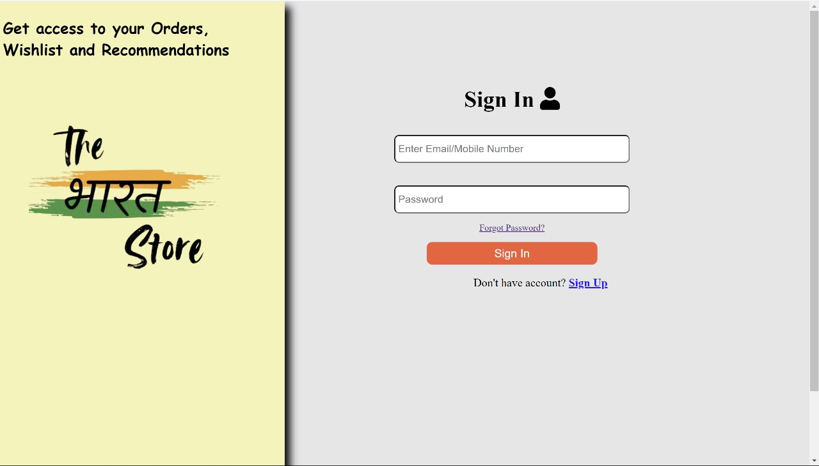
Project Highlights

Slide 11
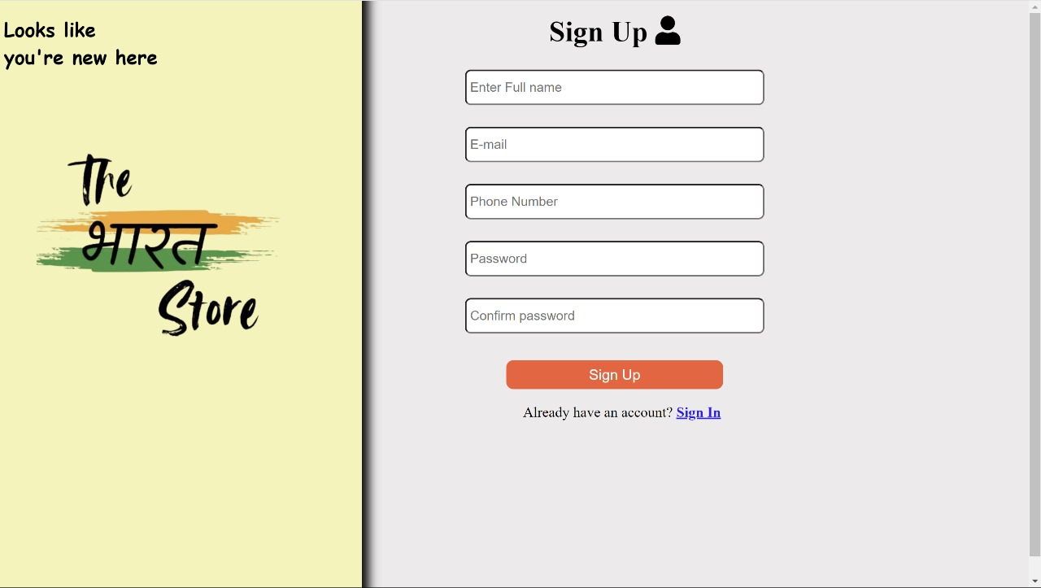
Sign Up Page

Slide 12
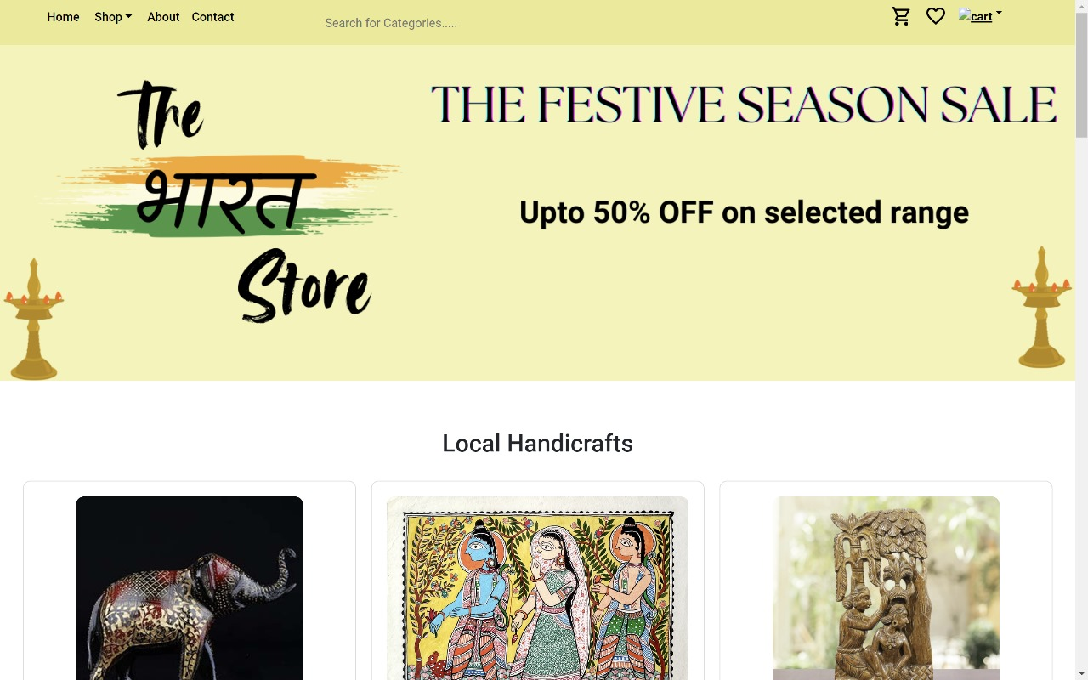
Home Page

Slide 13
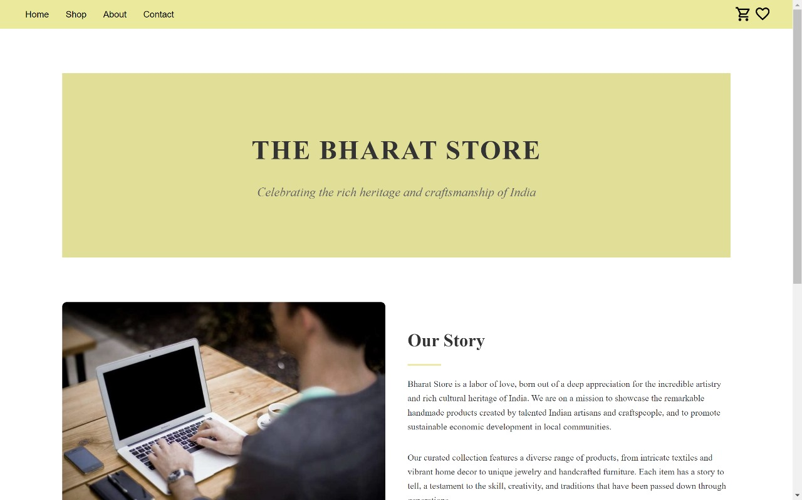
About Us

Slide 14
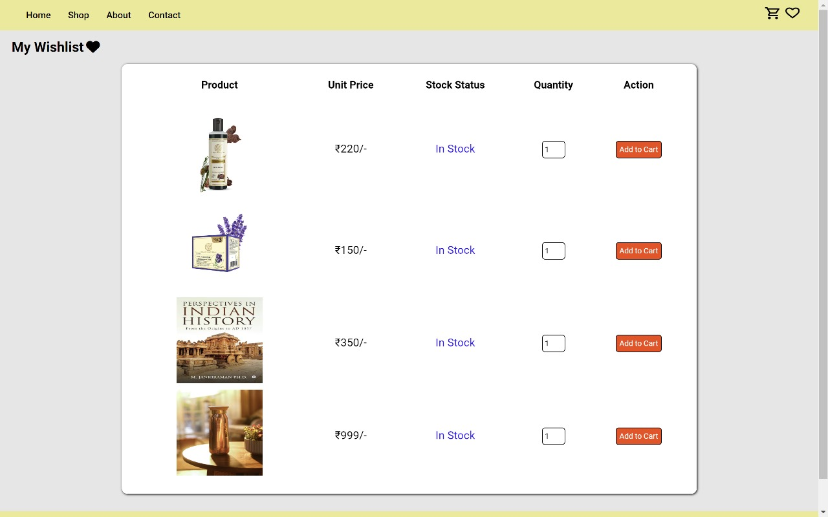
Wishlist

Slide 15
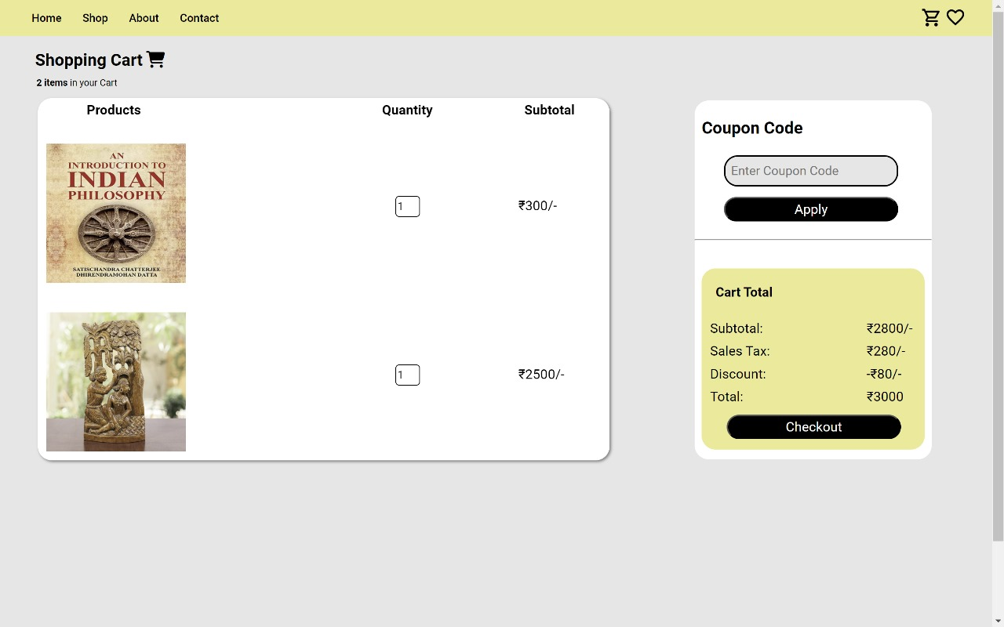
Cart

Slide 16
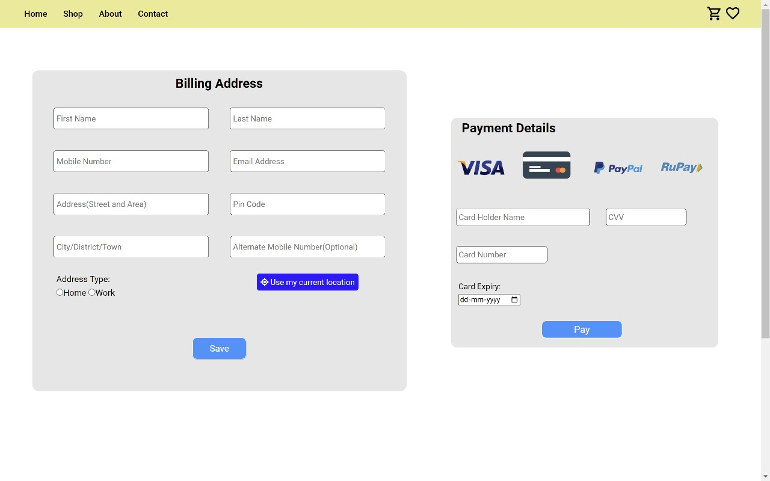
Payment

Slide 17
Conclusion
“The Bharat Store” celebrates Indian culture and craftsmanship through an e-commerce platform. Authentic products, vibrant designs, and festival-themed collections weave together tradition and innovation. As global patrons explore our aisles, they not only shop but also connect—with artisans, landscapes, and memories. “The Bharat Store” isn’t just commerce; it’s a cultural odyssey.

Slide 18
References/Links used
https://www.flipkart.com/
https://www.amazon.com/
https://www.gitagged.com/
https://www.ajio.com/

Slide 19


